Slide 1
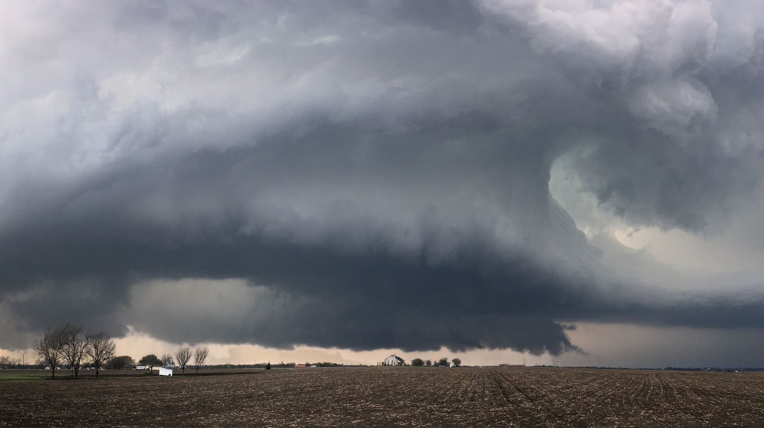
Correlation between temperature and precipitation

Slide 2

Hypothesis
To establish a relationship between temperature and precipitation
To predict precipitation values based on temperature data

Slide 3
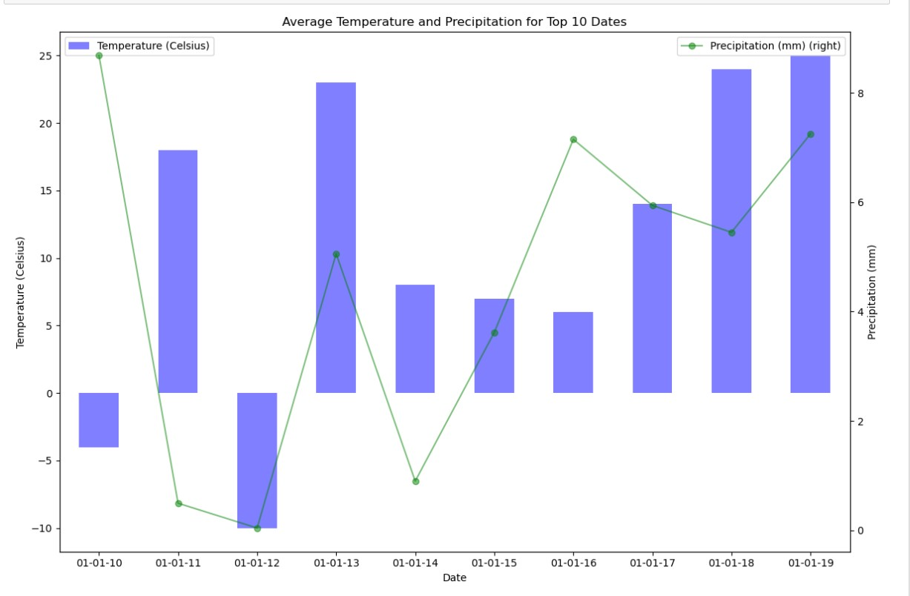

Slide 4
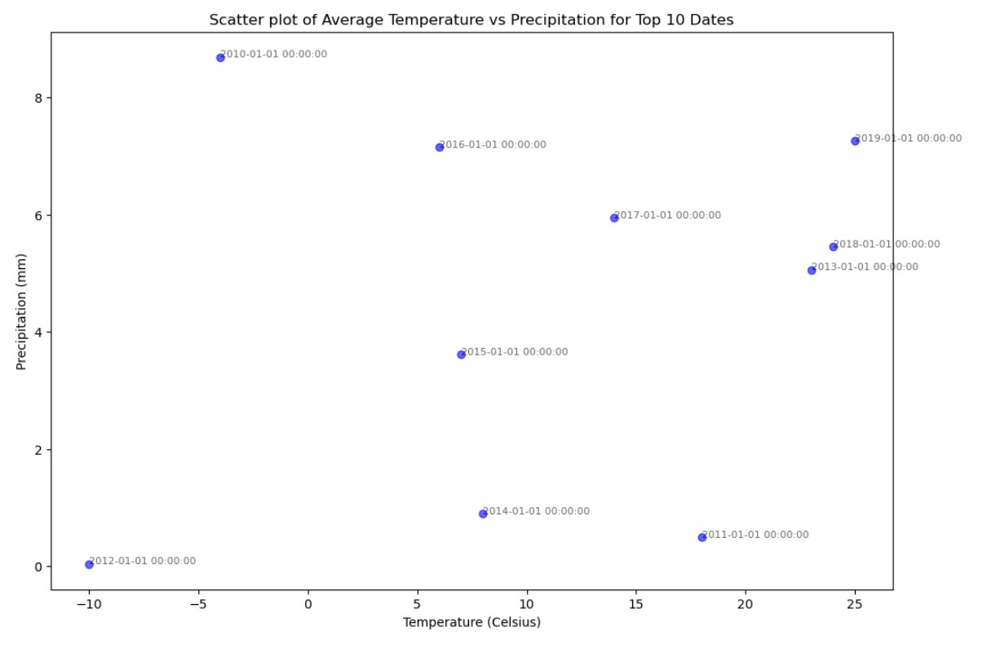

Slide 5
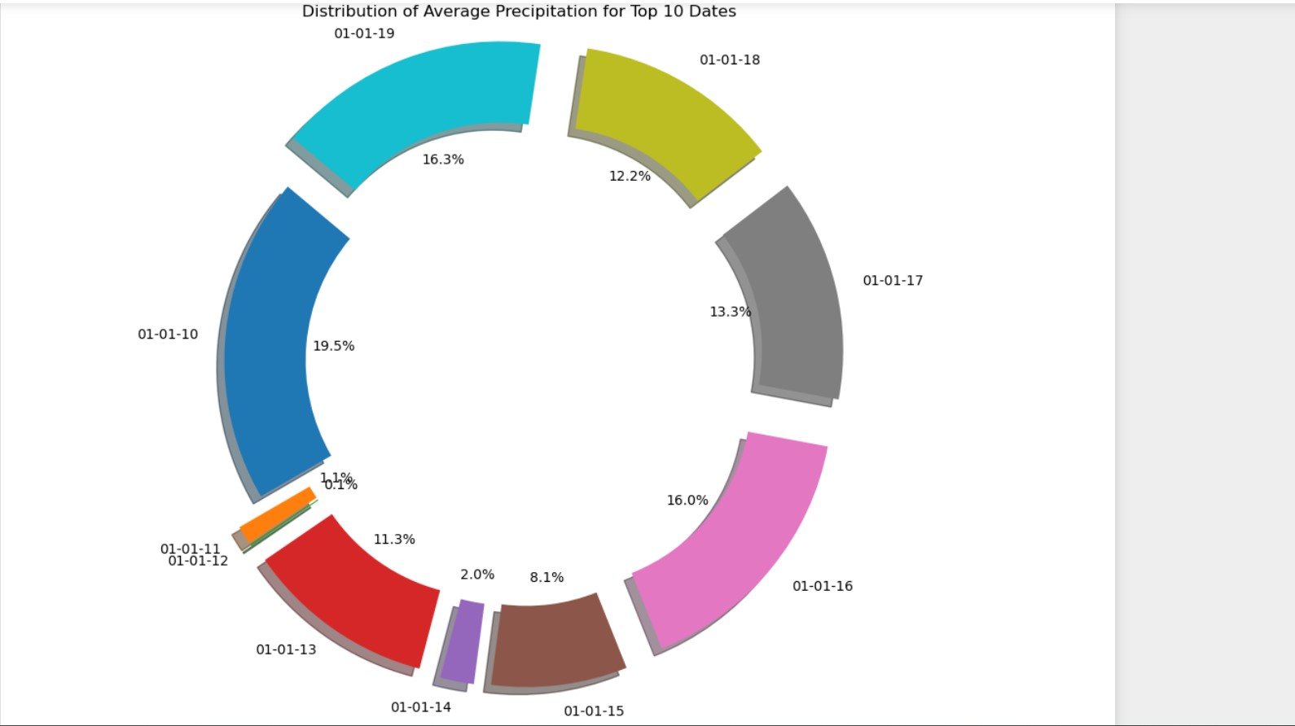

Slide 6
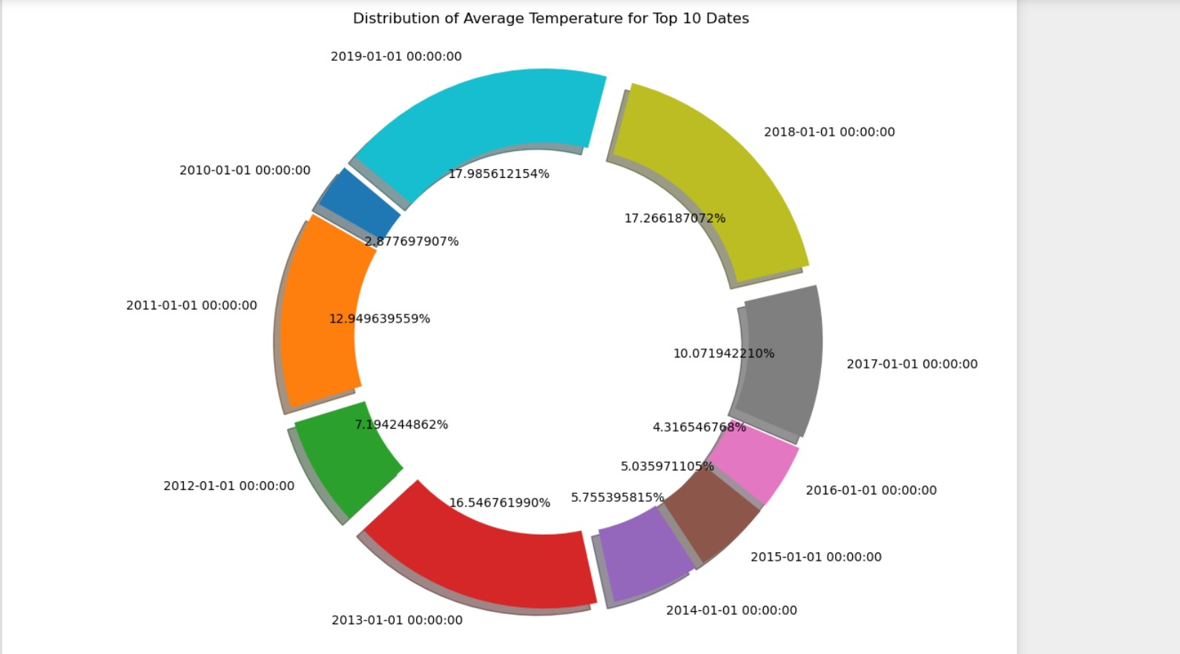

Slide 7
Next, we use a linear regression model to check if there’s any relationship between temperature and precipitation
The linear regression test is 0 which means that there is no linear relationship between temperature and precipitation.

Slide 8
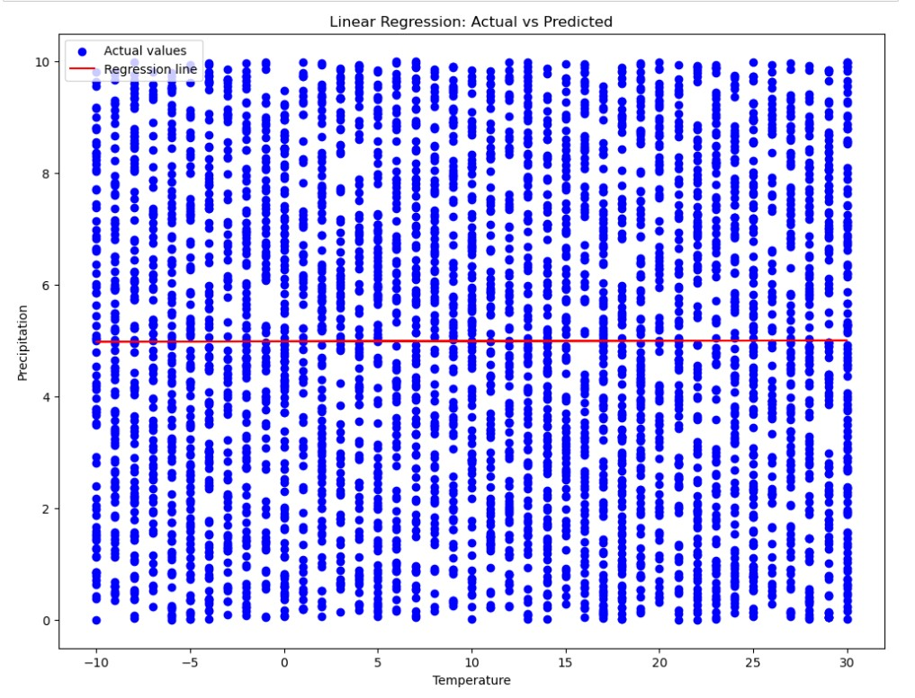

Slide 9
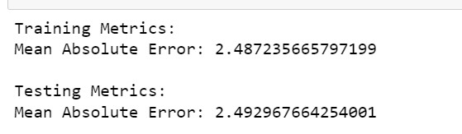
Decision Tree Regression
I used a decision tree regression in order to establish a relationship between temp and precipitation and predict precipitation based on temperature. As the linear relationship was proven to be 0, a decision tree seemed to be the best course of action to establish a non-linear relationship between the two attributes.
The second reason why I went with decision tree was because I was trying to predict continuous values instead of categorized values.

Slide 10
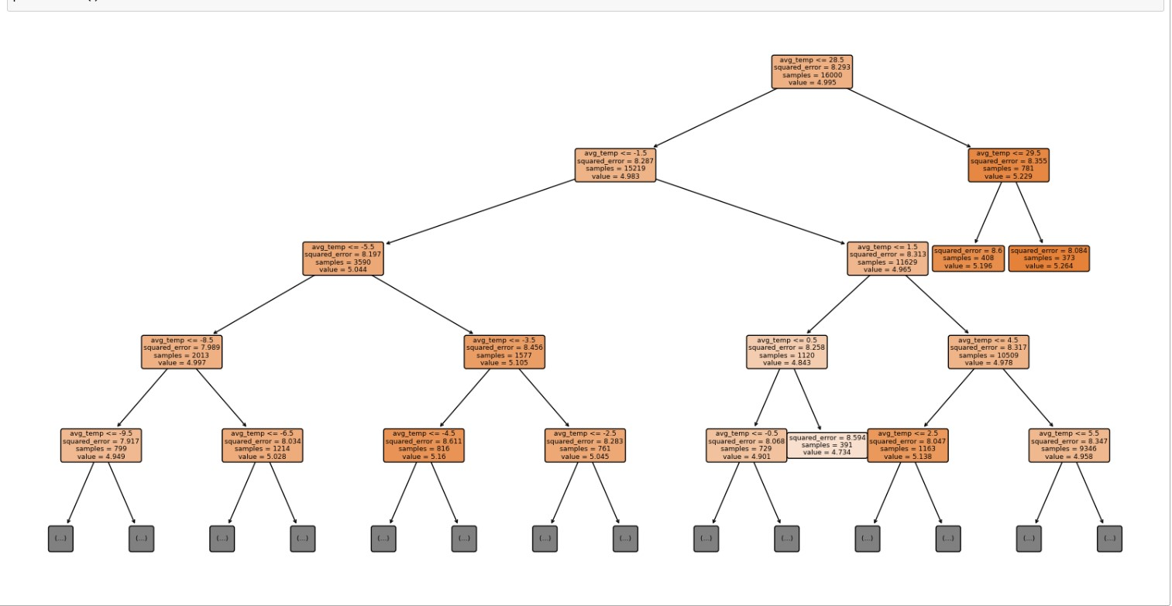

Slide 11
Conclusion
Based on the results of the mean Absolute error we can infer the following:
Training Metrics:
Mean Absolute Error: 2.487235665797199
Testing MAE: 2.492967664254001:
The training and testing MAE are close which means the model is consistent.
The model is prediction values for precipitation is on average 2.49 units away from actual values.
On average, the total squared error for this model is 8.1, which means the squared differences between the predicted and actual precipitation values sum up to this amount. This indicates there is a significant deviation between the predicted and actual values.
There is no relationship observed between precipitation and temperature based on this dataset. Using other regression models such as K N Neighbours to may establish such a relationship however, that remains to be seen.

